Slide 1
Angular Component Interaction

Slide 2
What is Component Interaction
Components are building blocks of angular application.
Each components serves specific purpose.
But sometimes component may need to interact with each other to get the Job done.

Slide 3
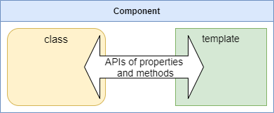
Binding (Interaction with in one component)
Component class, view Interaction Technique : Binding
Interpolation{{}}, Property binding[], Event binding(), Two-way binding[()]
Intercept✋ interaction to perform some operations
Two-way binding split
Getters and Setters

Slide 4
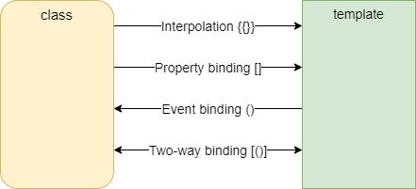
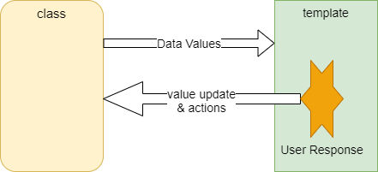
Binding
Binding: Interaction with in a component between class and template, by using APIs of properties and methods.

Slide 5
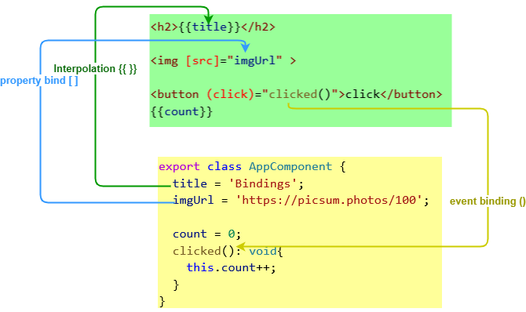
One way binding

Slide 6
One way binding…
Interpolation {{ }} : sets dynamic string values into templates.
Displaying values
<p>{{name}}</p>
<img src="{{itemImageUrl}}">
Template expressions
Evaluates expressions. {{1 + getVal()}}
Converts ‘the expression results’ to strings.
Links the results to any adjacent literal strings.
Assigns the composite to an element or directive property. {{count=count +1}}
These Js expressions can not use:
Assignments (=, +=, -=, ...)
operators ++ and --
Chaining with ; or ,
Operators such as new, typeof, or instanceof

Slide 7
One way binding…
Property binding [ ] : sets a specific element property.
Event binding ( ) : listens for an element change event.

Slide 8
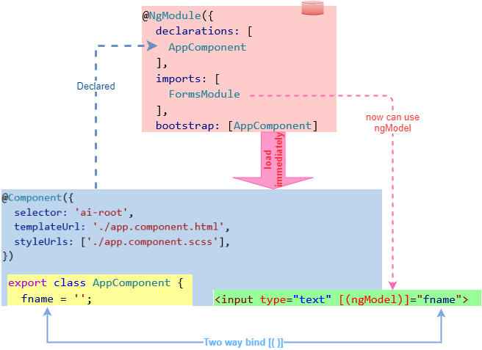
Two way binding

Slide 9
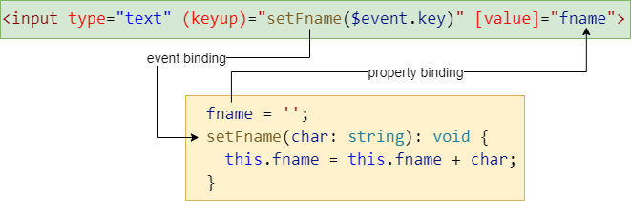
Two way binding...
If your input tag with in form tag you should add name property.
Form>input[_name=“fname”
Like two way binding…

Slide 10
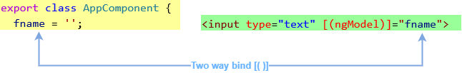
Execute additional code when binding
When class ←→ template interact.
Two way binding [( )] ensures both ‘view and class instant variable’ are in sync.
But we want to execute some extra lines of code.
For example we contently track one variable.
split two way binding.
Getters and Setters with ngModel

Slide 11
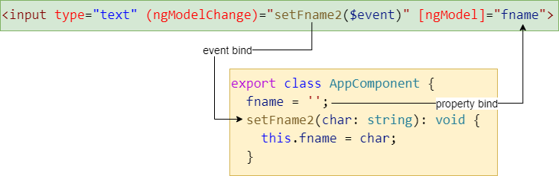
split two way binding…
Now we can add additional logic within the method.

Slide 12
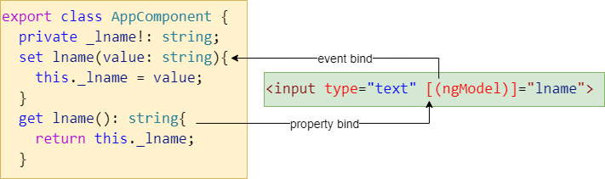
ngModel setters and getters
So if want additional code put it into the setter.

Slide 13
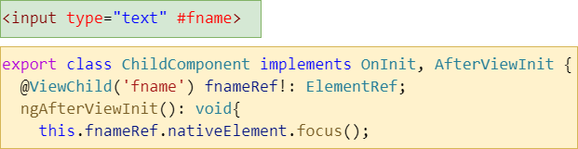
Access DOM element form class

Slide 14
Directives
3 type of built-in directives.
Component
attached with template.
Attribute directives
change appearance/ behavior/ behavior ➔ of element/ component/ directive.
NgClass CSS classes. <div [ngClass]=‘isSpecial? special:”” ‘>
NgStyle HTML styles. <div [ngStyle]=‘currentStyleObject‘>
NgModel two-way binding to HTML form element.
Structural directives
changing the DOM layout by adding/ removing DOM elements.
NgIf conditionally creates subviews.
NgFor repeat a node.
NgSwitch set of directives switch among alternative.

Slide 15
component lifecycle hooks
ngOnChanges()
Called whenever an @input value changes.
first call: before ngOnInit.
ngOnInit()
Initialize data, called after constructor.
Called only once.
ngDoCheck()
Called when any change detection.
Run through the view to detect changes.
ngOnDestory()
Used to cleanup any code when a component is form the DOM.
Called only once before component is removed form the DOM.
ngAfterContentInit()
Called only once ager “first ngDoCheck()”
Called after first run through of initializing content.
ngAfterContentChecked()
Called after every ngDoCheck()
ngAfterViewInit()
Called after initializes component and child component content.
Called only once after view initialize.
ngAfterViewChecked()
Called after content is initialized and checked. (component and child component).
First call: after ngAfterViewInit()
Called after every ngAfterContentChecked()

Slide 16
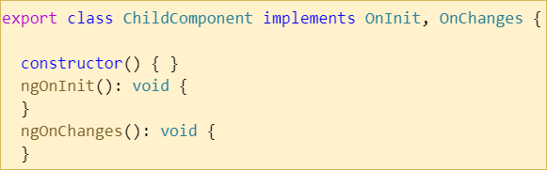
component lifecycle hooks…
In order to work with LifeCycle Hooks we need to implements the interface, then override that method.
ngOnInit() is available by default all components that you crate.

Slide 17
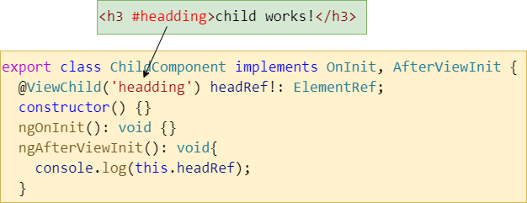
@viewChild and @viewChildren
Search for the element/elements in view(component’s template).

Slide 18
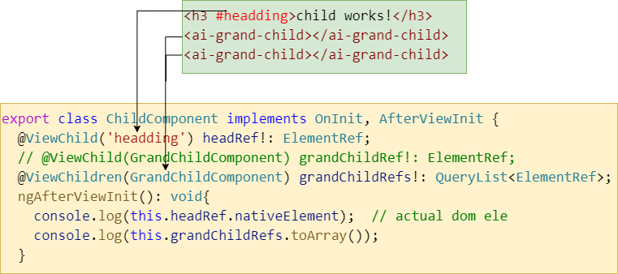
@viewChild and @viewChildren…

Slide 19
Inter component interaction
Parent → child
@Input()
@Input() and Getters Setters
@Input() and ngOnChanges()
Parent ← child
Template reference variables
@viewChild()
Emitting events
Services

Slide 20
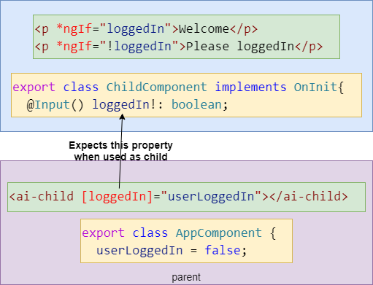
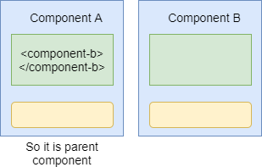
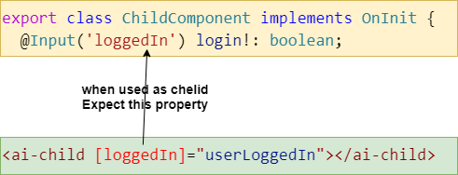
Parent ➔ Child @Input
Example shows How we maintain one common property in the patent component.

Slide 21
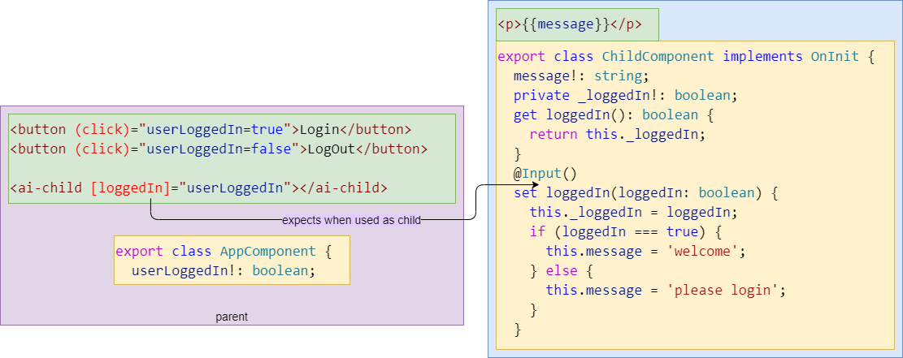
Parent ➔ Child || @Input & Getters Setters

Slide 22
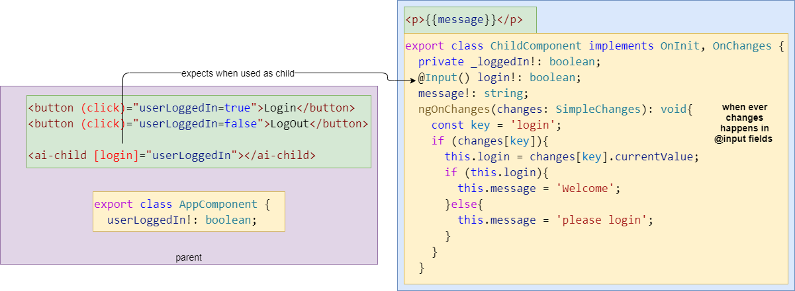
Parent ➔ Child || @Input & ngOnChanges

Slide 23
Parent ➔ Child…
Getters and Setters VS ngOnChanges
Both used to intercept input property value and execute additional code.
But you can use …
Getters and setters : if there is only one input property
ngOnChanges : if there are many input properties
ngOnChanges gives simpleChange object
current Value, previous Value, first Change can use these if it’s needed.

Slide 24
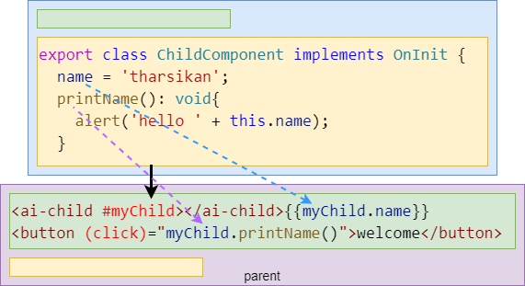
Parent ⬅ Child || template reference
Parent component can directly access the property and method of the child component.
By using template reference variable in the template.

Slide 25
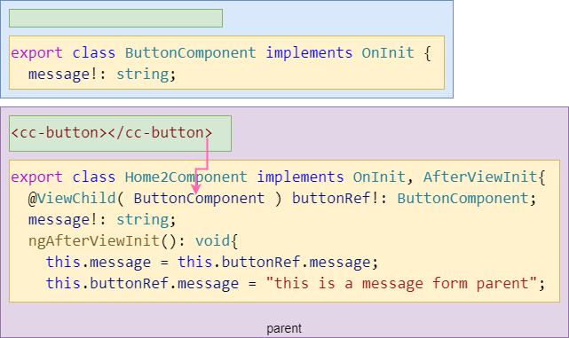
Parent ⬅ Child || @viewChild
Earlier in this course we show how to access DOM element within a component (class← template). It is also similar approach.

Slide 26
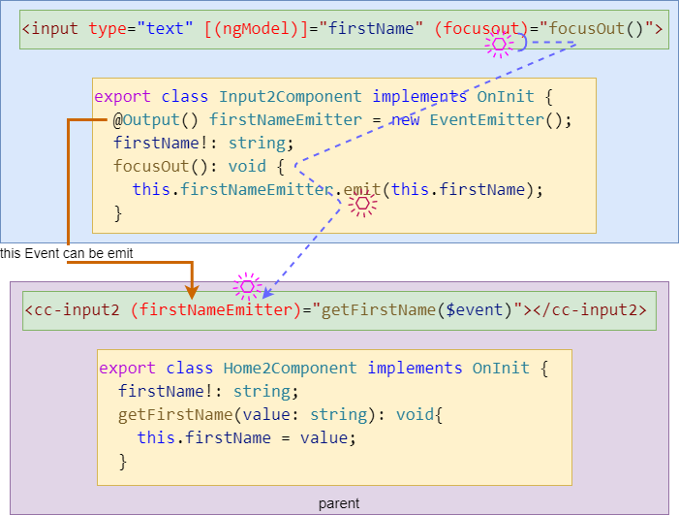
Parent ⬅ Child || @Output & EventEmit

Slide 27
Parent ⬅ Child || @Output & EventEmit

Slide 28
Reactive Programming
Imperative Programming (java)
Functional Programming (JS)
How program works
Easy learning curve
Functions, conditions, loops, OOP concepts
Statements can change the state of the program
If(x%2==0 || x% 3 ==0 ) list.add(x)
What to solve
Long learning curve & migrations
Ideally to be stateless
Use functions to create expressions rather than statements.
var filter=x=>{return x%2==0 || x%3==0}

Slide 29
What is RP
Way of programming allow us to manipulate streams of data using functions.
Every thing mean to happens asynchronously.
One processor(place) starts to do some operations on part of streams data, that result being consumed by other place.

Slide 30
When to use RP
Prerequisites: data should comes as stream, good knowledge in functional programming, Asynchronous observers (non-blocking).
Can use anywhere, where it take time to process the request.
Example: calling rest API over http to fetch some data and filter and populate on UI.
Observer can wait for notification when ever notification comes you can logit, until you don’t need to block other processes.
Fetching data asynchronously so can do some other tasks at that time.

Slide 31
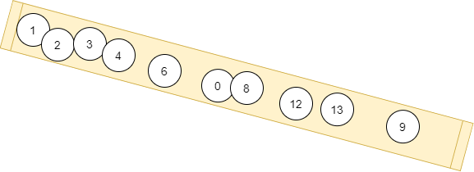
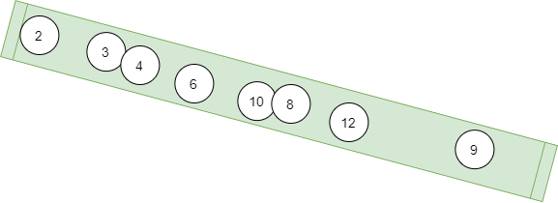
RP
Source (stream) who emit the data is Subject
Entity who subscribed to the subject to consume the data is Observer
RxJava, RxJs, Rx.Net using these libraries we can do RP in java, JS, .net. for Angular NgRx is the library which contains extra features.

Slide 32

RxJS in Angular
Streams
Start(subscribe)
Starts emitting data
Observe the stream and do set of processes(observer)
Get the next and process : next()
Handle if any error : error()
End of operation : complete()
Stop (unsubscribe)

Slide 33
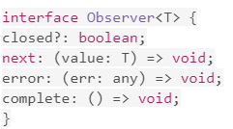
Observer and Observable
Observer 👁 is the interface which is used to feed an observable 🎁 source
ob

